Slide 1




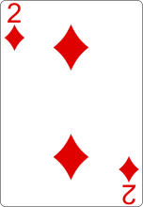
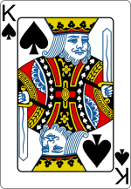
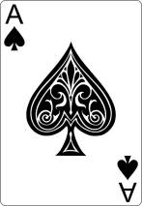

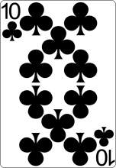
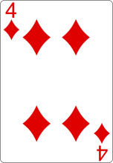
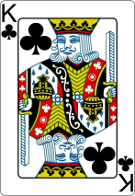


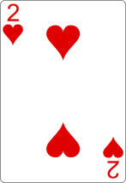
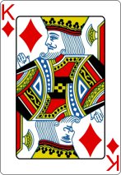
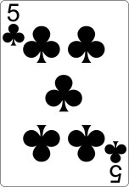
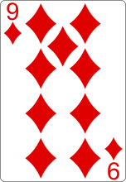
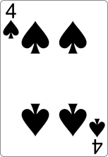
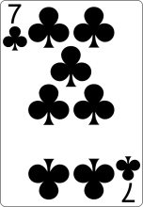

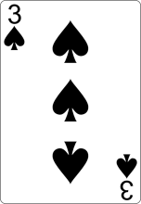
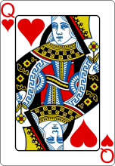


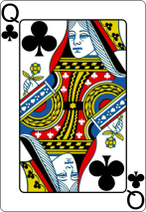
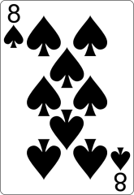
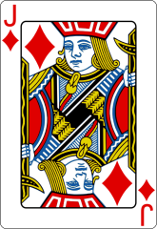
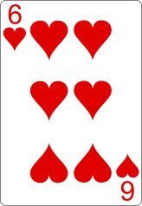
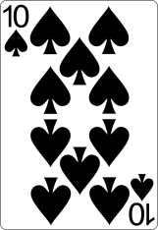
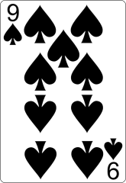
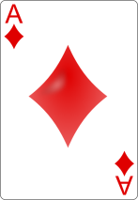
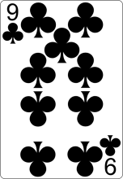
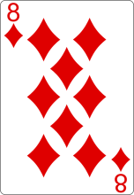
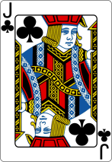
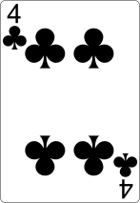
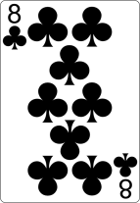
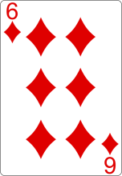
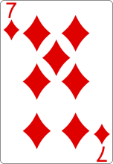
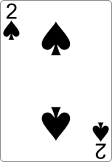



Bet Pools
Instant: $0
Line 1: $0
Line 2: $0 Community: $0
Bank Roll
Player 1: $1000
Player 2: $750
Player 3: $1600
Player 4: $1500
Player 5: $450
Player 6: $300
Player 7: $350
Player 8: $300
Player 9: $800
Player 10:$1500
Player Standings
Player 1:
Player 2:
Player 3:
Player 4:
Player 5:
Player 6:
Player 7:
Player 8:
Player 9:
Player 10:
Copyright © 2013 – Edward Bradley & Ricardo Guzman
Notes:
Copyright 2013 - Edward Bradley & Ricardo Guzman

Slide 2

Ante Round
Copyright © 2013 – Edward Bradley & Ricardo Guzman
2

Slide 3

Ante Round
Copyright © 2013 – Edward Bradley & Ricardo Guzman

Slide 4
Round 1
Copyright © 2013 – Edward Bradley & Ricardo Guzman
13
Notes:
Copyright 2013 - Edward Bradley & Ricardo Guzman

Slide 5
Round 2
Copyright © 2013 – Edward Bradley & Ricardo Guzman

Slide 6
Round 3
Copyright © 2013 – Edward Bradley & Ricardo Guzman

Slide 7
Round 4

Slide 8

Round 5
Copyright © 2013 – Edward Bradley & Ricardo Guzman

Slide 9








Close Out
Bet Pools
Instant: $0
Line 1: $1410
Line 2: $800 Community: $2950
Bet Pools
Instant: $0
Line 1: $1314
Line 2: $0 Com:$3064(+1444)
Copyright © 2013 – Edward Bradley & Ricardo Guzman

